Slide 1
Applications of Sequence Classification
(Parts of speech)

Slide 2
Sequence Classification
Sequence classification is a predictive modeling problem where you have some sequence of inputs over space or time, and the task is to predict a category for the sequence.

Slide 3
Sequence classification is a predictive modeling problem where you have some sequence of inputs over space or time and the task is to predict a category for the sequence.
What makes this problem difficult is that the sequences can vary in length, be comprised of a very large vocabulary of input symbols and may require the model to learn the long-term context or dependencies between symbols in the input sequence.

Slide 4
Applications
Speed analysis
Speech recognition
Part-of-speech tagging
Machine translation
Handwriting recognition
Time series analysis
Activity recognition
Sequence classification

Slide 5
Hidden Markov Model (HMM)
A Hidden Markov Model (HMM) is a statistical model which is also used in machine learning. It can be used to describe the evolution of observable events that depend on internal factors, which are not directly observable. These are a class of probabilistic graphical models that allow us to predict a sequence of unknown variables from a set of observed variables. We will also discuss the use of HMM for (Parts of Speech tagging)PoS in detail.
Mainly used for sequential and temporal data
Simple and powerful
Through HMM we can compute the probability for distribution of event that can be observed.
HMM is based on, Markov process, and Markov chain, Markov property
The Markov property means that evolution of the Markov process in the future depends only on the present state and does not depend on past history. The Markov process does not remember the past if the present state is given. Hence, the Markov process is called the process with memoryless property.

Slide 6
Hidden Markov Model
The HMM is based on augmenting the Markov chain. A Markov chain is a model that tells us something about the probabilities of sequences of random variables, states, each of which can take on values from some set. These sets can be words, or tags, or symbols representing anything, like the weather. A Markov chain makes a very strong assumption that if we want to predict the future in the sequence, all that matters is the current state. The states before the current state have no impact on the future except via the current state. It’s as if to predict tomorrow’s weather you could examine today’s weather but you weren’t allowed to look at yesterday’s weather

Slide 7
Markov assumption
More formally, consider a sequence of state variables q1,q2,...,qi . A Markov model embodies the Markov assumption on the probabilities of this sequence: that Markov assumption when predicting the future, the past doesn’t matter, only the present.
Markov Assumption: P(qi = a|q1...qi−1) = P(qi = a|qi−1)
Figure A.1a shows a Markov chain for assigning a probability to a sequence of weather events, for which the vocabulary consists of HOT, COLD, and WARM. The states are represented as nodes in the graph, and the transitions, with their probabilities, as edges. The transitions are probabilities: the values of arcs leaving a given state must sum to 1.

Slide 8
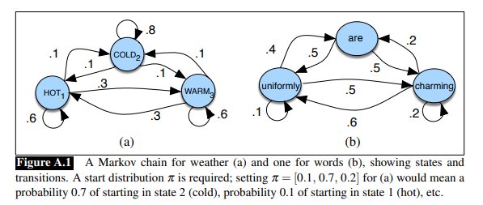

Slide 9
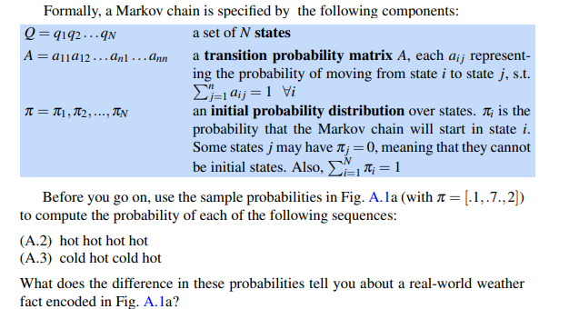

Slide 10
Parts of speech
Back in elementary school, we have learned the differences between the various parts of speech tags such as nouns, verbs, adjectives, and adverbs. Associating each word in a sentence with a proper POS (part of speech) is known as POS tagging or POS annotation. POS tags are also known as word classes, morphological classes, or lexical tags.

Slide 11
Back in the days, the POS annotation was manually done by human annotators but being such a laborious task, today we have automatic tools that are capable of tagging each word with an appropriate POS tag within a context.
Nowadays, manual annotation is typically used to annotate a small corpus to be used as training data for the development of a new automatic POS tagger. Annotating modern multi-billion-word corpora manually is unrealistic and automatic tagging is used instead.
POS tags give a large amount of information about a word and its neighbors. Their applications can be found in various tasks such as information retrieval, parsing, Text to Speech (TTS) applications, information extraction, linguistic research for corpora. They are also used as an intermediate step for higher-level NLP tasks such as parsing, semantics analysis, translation, and many more, which makes POS tagging a necessary function for advanced NLP applications.

Slide 12
In this, you will learn how to use POS tagging with the Hidden Makrow model.

Slide 13
Application of Hidden Markov Model
An application, where HMM is used, aims to recover the data sequence where the next sequence of the data can not be observed immediately but the next data depends on the old sequences. Taking the above intuition into account the HMM can be used in the following applications:

Slide 14
Applications of HMM
Speed analysis
Speech recognition
Part-of-speech tagging
Machine translation
Handwriting recognition
Time series analysis
Activity recognition
Sequence classification
Transportation forecasting

Slide 15
HMM (Hidden Markov Model) is a Stochastic technique for POS tagging. Hidden Markov models are known for their applications to reinforcement learning and temporal pattern recognition such as speech, handwriting, gesture recognition, musical score following, partial discharges, and bioinformatics.

Slide 16
Hidden Markov Models in NLP
From the above application of HMM, we can understand that the applications where the HMM can be used have sequential data like time series data, audio, and video data, and text data or NLP data. In this article, our main focus is on those applications of NLP where we can use the HMM for better performance of the model, and here in the above-given list, we can see that one of the applications of the HMM is that we can use it in the Part-of-Speech tagging..

Slide 17
Applications of sequence classification such as part-of-speech tagging using HMM
POS tagging with Hidden Markov Model

Slide 18
part-of-speech tagging
Tagging is a kind of classification that may be defined as the automatic assignment of description to the tokens. Here the descriptor is called tag, which may represent one of the part-of-speech, semantic information and so on.
Now, if we talk about Part-of-Speech (PoS) tagging, then it may be defined as the process of assigning one of the parts of speech to the given word. It is generally called POS tagging. In simple words, we can say that POS tagging is a task of labelling each word in a sentence with its appropriate part of speech. We already know that parts of speech include nouns, verb, adverbs, adjectives, pronouns, conjunction and their sub-categories.
Most of the POS tagging falls under Rule Base POS tagging, Stochastic POS tagging and Transformation based tagging.

Slide 19
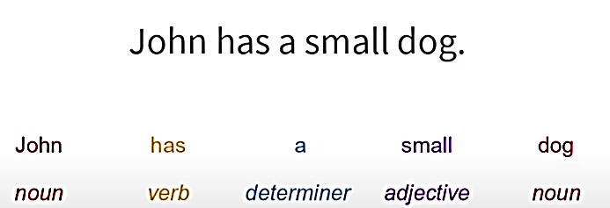
Given a sentence, predict the tag of each word

Slide 20
Where is Parts of Speech used:
Grammatical Analysis of text
Spell Check

Slide 21
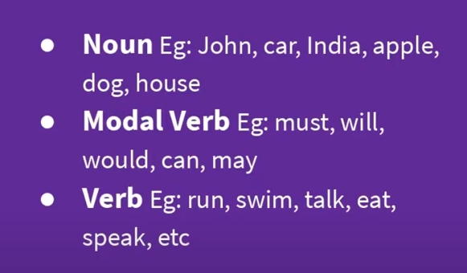
Parts of speech

Slide 22
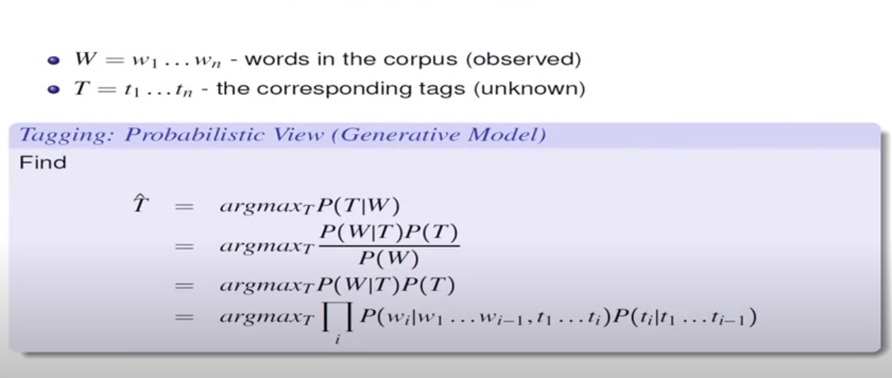

Slide 23
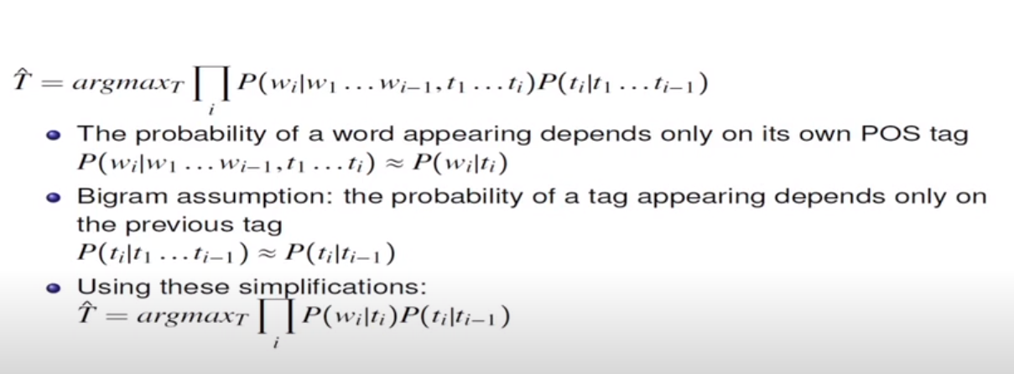

Slide 24


Transition probability
Word likelihood probabilities or Emission probabilities

Slide 25
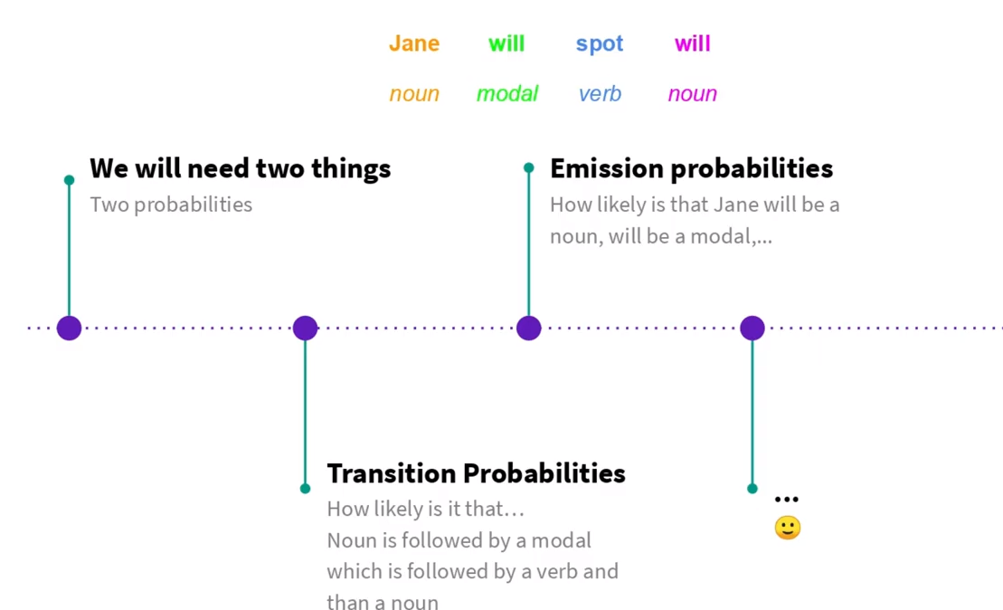
Predict the tags for the following sentence

Slide 26
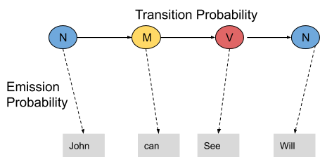
Transition Probability

Slide 27

Transition probability
The transition probability is the likelihood of a particular sequence for example, how likely is that a noun is followed by a model and a model by a verb and a verb by a noun. This probability is known as Transition probability. It should be high for a particular sequence to be correct.

Slide 28
Emission probability.
What is the probability that the word Ted is a noun, will is a model, spot is a verb and Will is a noun. These sets of probabilities are Emission probabilities and should be high for our tagging to be likely.

Slide 29
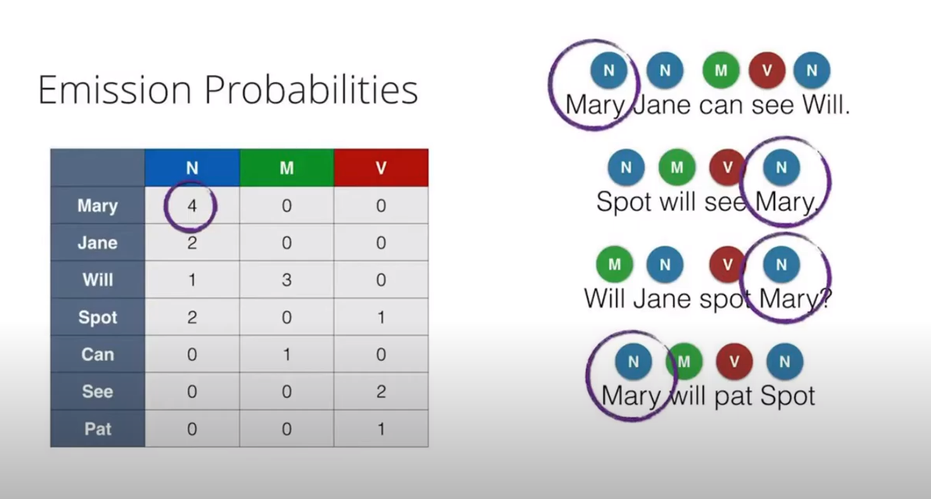
Count how many times a word occurs as Noun, modal or verb

Slide 30
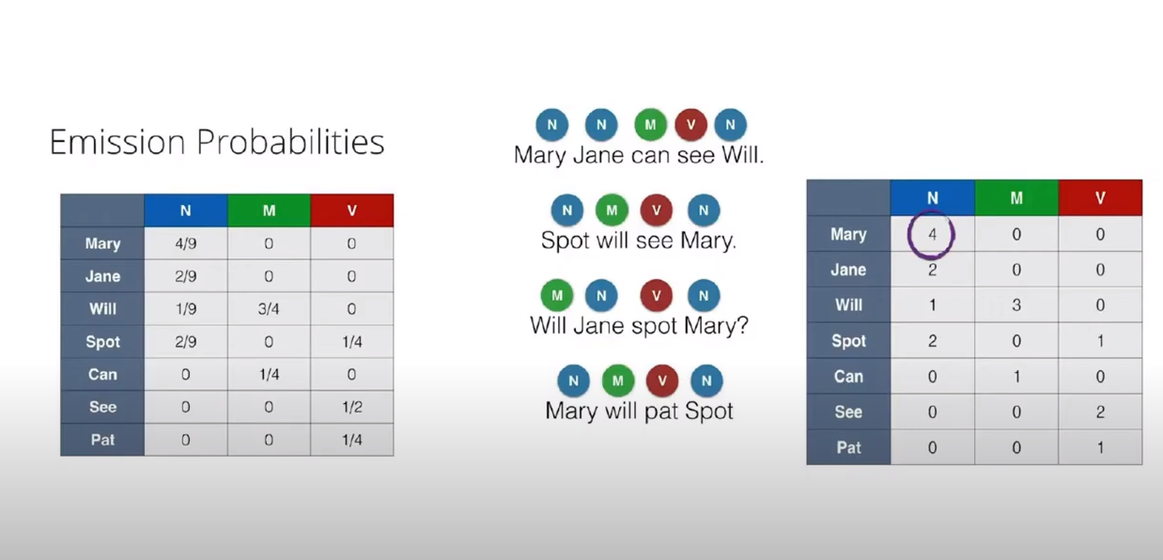
Calculate Emission Probabilities
Column sum

Slide 31
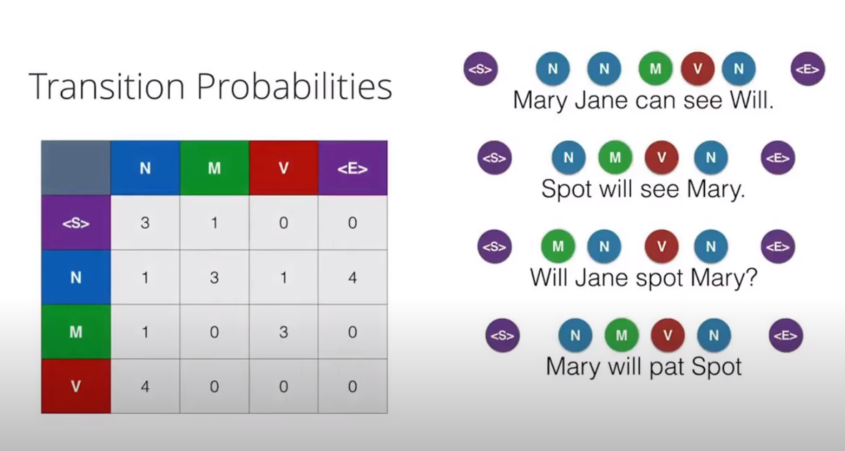
Transition Probabilities

Slide 32
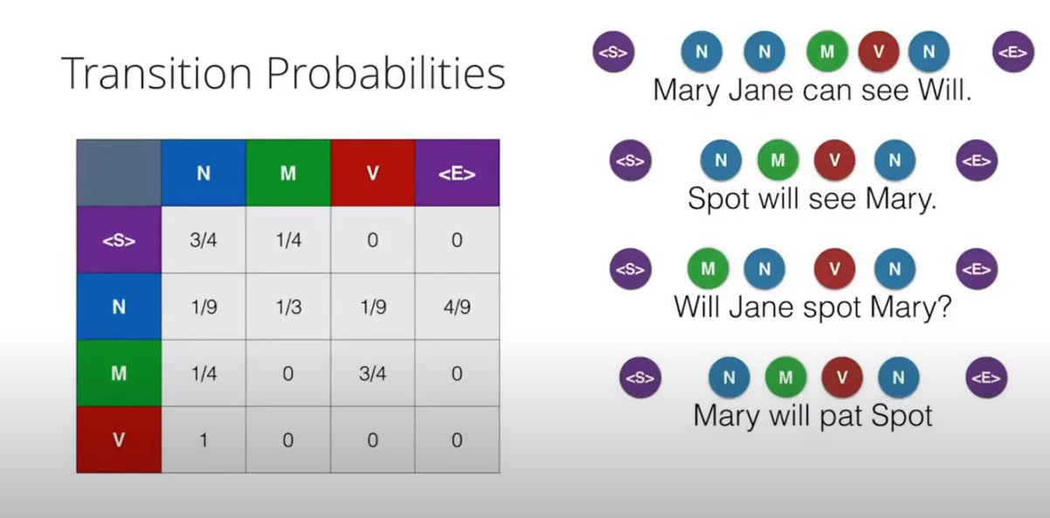
Transition Probabilities
Row sum

Slide 33
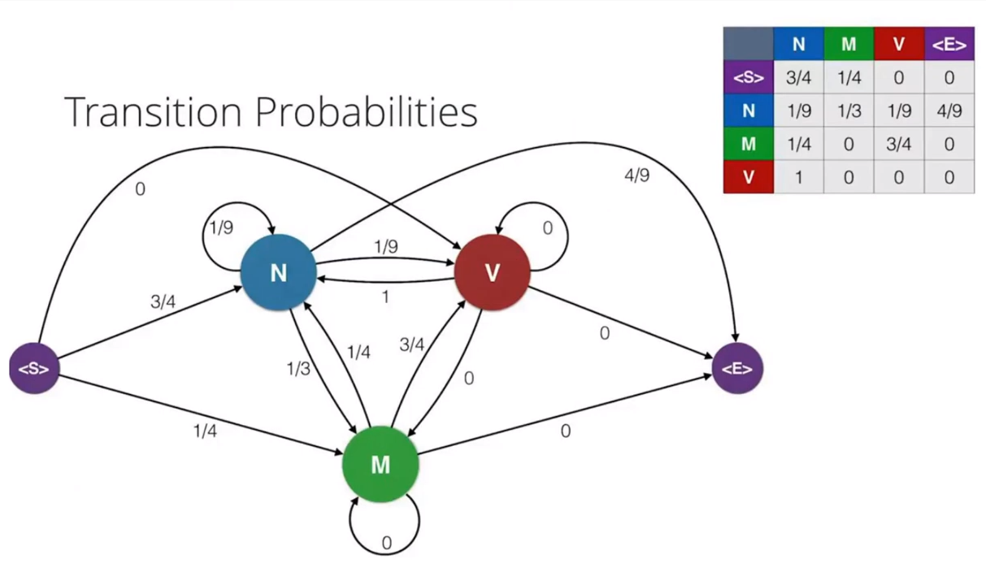
Hidden Markov model

Slide 34
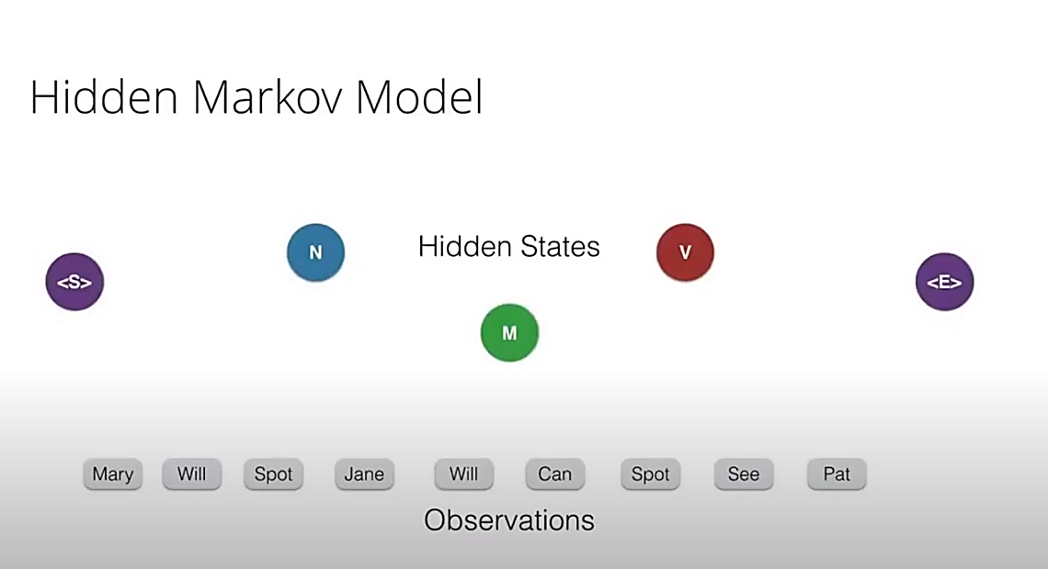
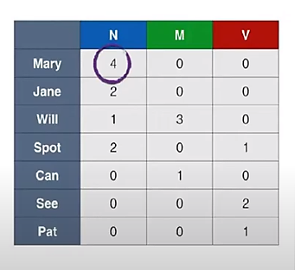

Slide 35
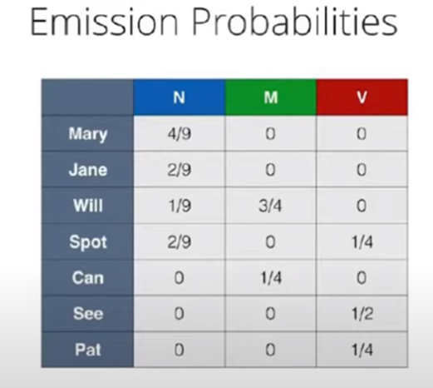
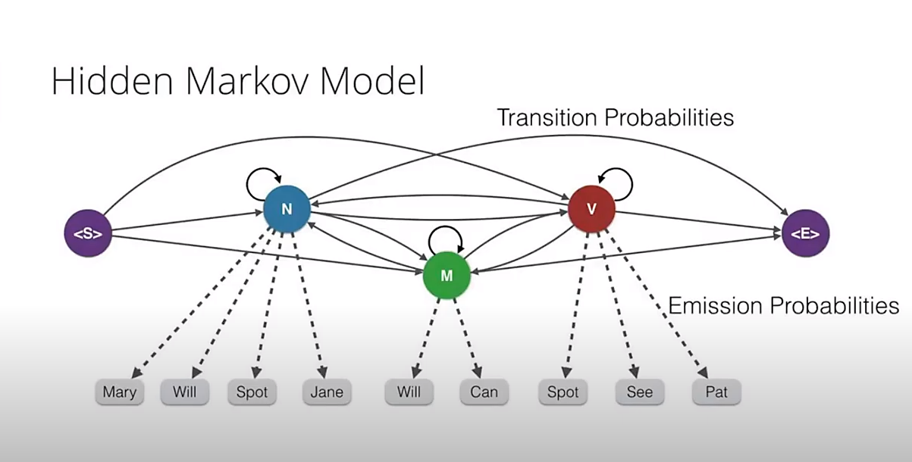

Slide 36
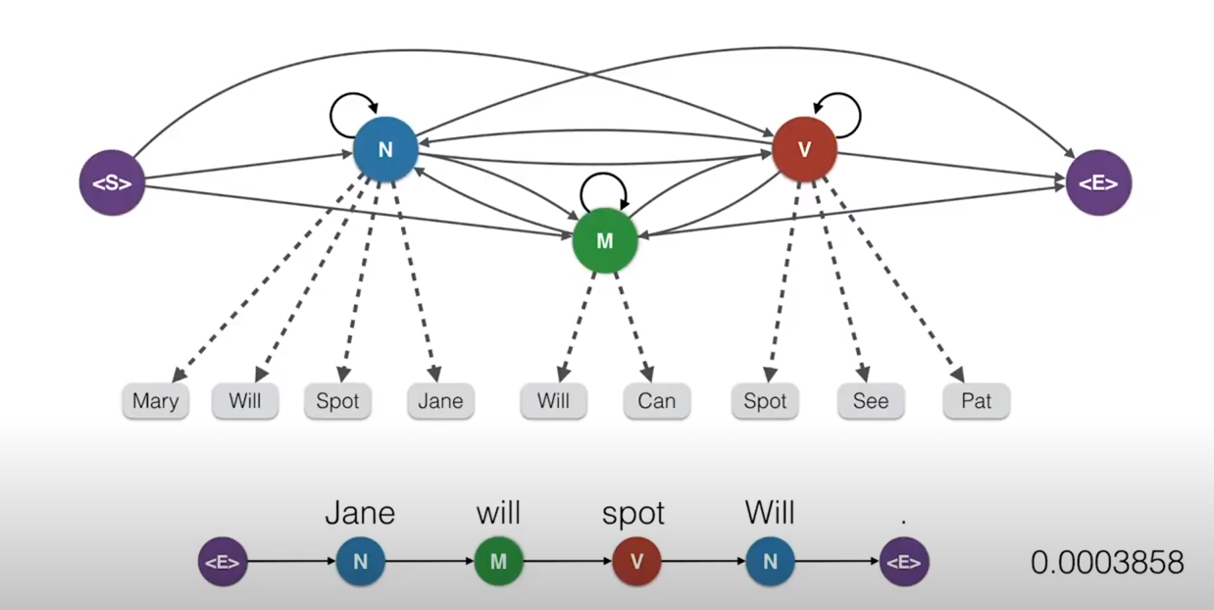
Question: Jane will spot Will: predict Parts of speech

Slide 37
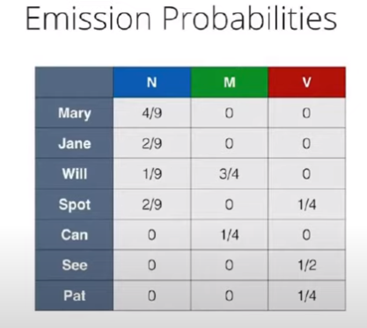
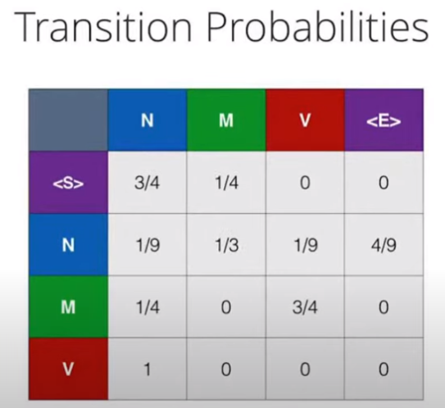
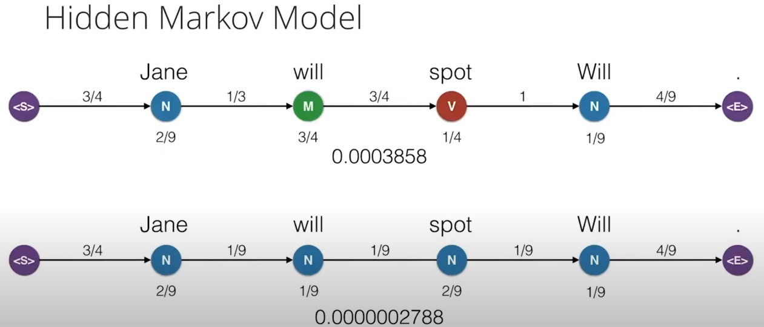
Take this sequence of states as more probability for this sequence (multiplying all probabilities)

Slide 38
POS (Part-of-Speech) tagging with Hidden Markov Model (mygreatlearning.com)
Part-of-speech (POS) tagging with Hidden Markov Model (HMM) – YouTube
POS (Part-of-Speech) tagging with Hidden Markov Model | Great Learning (mygreatlearning.com)

